Slide 1
Thousands of tests across
500 endpoints, in an afternoon
What we learned asking agents to write API tests, and why a green result still needs checking.
Prairie Dev Con 2026 · Tri Ho, Futurify
Prairie Dev Con 2026 · Tri Ho, Futurify
Notes:
Testing is how we verify that a system does what the specification says and handles gracefully what the specification forgot. This talk is about generating thousands of API test cases against more than 500 endpoints in hours rather than months, and about the several ways that can quietly go wrong.

Slide 2
01 · WHERE THIS STARTS
Testing used to be something we typed out by hand
When I was still writing production code, a good day meant a few classes and the tests that went with them.
A few classes a day
Boundary cases from memory
Tests on every merge
That was a fair output for one developer writing the code and its unit tests together.
Negative amounts, fractions, very large values and very small ones. You thought of each case yourself, and you missed some.
Unit, integration and end to end. The discipline was the point, and it took real time.
The limit was never a shortage of ideas. It was how quickly a person could write the cases down.
Prairie Dev Con 2026 · Tri Ho, Futurify
Notes:
Story from my own coding days: boundary tests on payment amounts, negative, fractional, normal, very large, very small. Everything that follows is about that typing limit being lifted, and what breaks when it is.

Slide 3
02 · TDD
TDD is simple to describe, and most teams still do not practise it
Write the empty function, write the tests that fail against it, then write the code that makes them pass.
Writing code is how many of us think
The incentives point somewhere else
Developers want to see the path in their head first, so writing the assertions up front can feel like delivering the punch line before the joke.
People are asked whether the feature is finished. They are rarely asked whether the cases are covered.
There is a QA team down the hall
Deadlines win in the end
When someone else is accountable for testing, careful testing tends to stop and the ticket simply comes back.
The practice holds while the code base is small, and it tends to be set aside once the schedule tightens.
Prairie Dev Con 2026 · Tri Ho, Futurify
Notes:
Walk through the mechanics quickly, then the four reasons it does not survive contact with a team. The punch-line line usually lands with a developer audience.

Slide 4
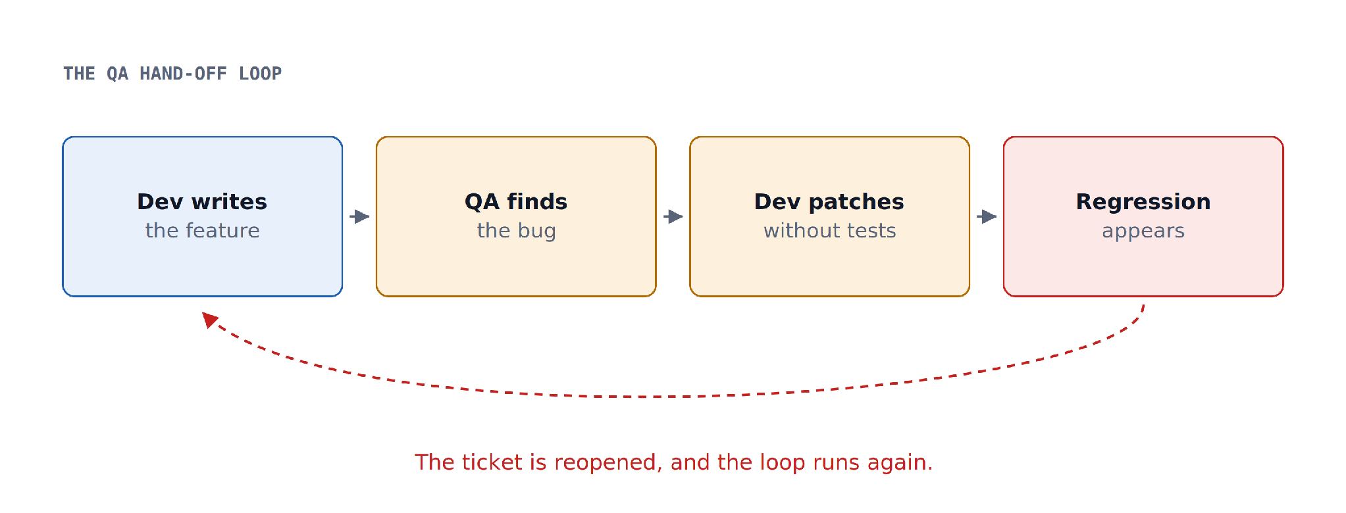
02 · TDD
What tends to happen instead
Each patch made without coverage is another chance to break something nearby, so the ticket comes back. Management then asks for automated testing, and the automation has its own catching up to do.
Prairie Dev Con 2026 · Tri Ho, Futurify
Notes:
The QA hand-off loop. Developers stop testing thoroughly because QA will catch it, the patch goes in without coverage, a regression follows, and QA rejects it again.

Slide 5
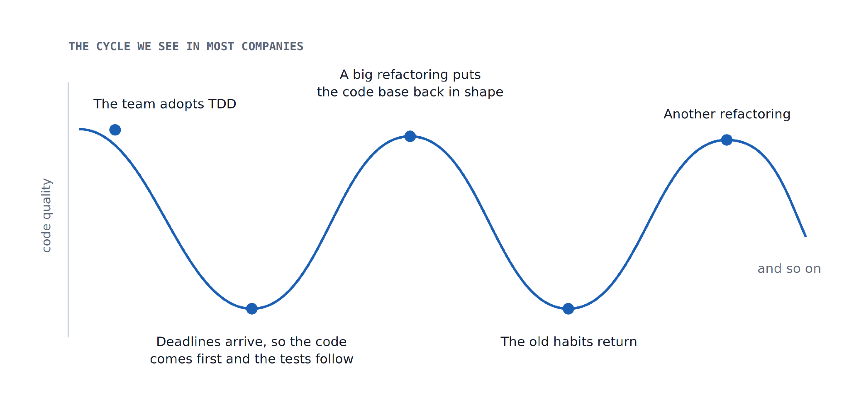
02 · TDD
Even with TDD, quality tends to move in a cycle
A green suite can give a comfortable feeling that everything works, and cases still get missed.
Prairie Dev Con 2026 · Tri Ho, Futurify
Notes:
Teams start with TDD, deadlines push them to code first, the code base gets messy, a big refactoring puts it back in shape, and then the old habits return. This is the cycle we see in most of the companies we are brought into, and it is usually why we get the call.

Slide 6
03 · THE CALL WE GET
“Our software is like a 1995 Pontiac. It still runs,
but a warning light comes on every time you drive it.”
You fix the tail lights and the headlights go out. Then smoke comes out of the engine.
They wanted a Corvette, and they were quite clear that a second-hand one would do.
— an executive, at the start of an engagement
Prairie Dev Con 2026 · Tri Ho, Futurify
Notes:
Real quote, and a good set-up for what a rescue engagement actually involves.

Slide 7
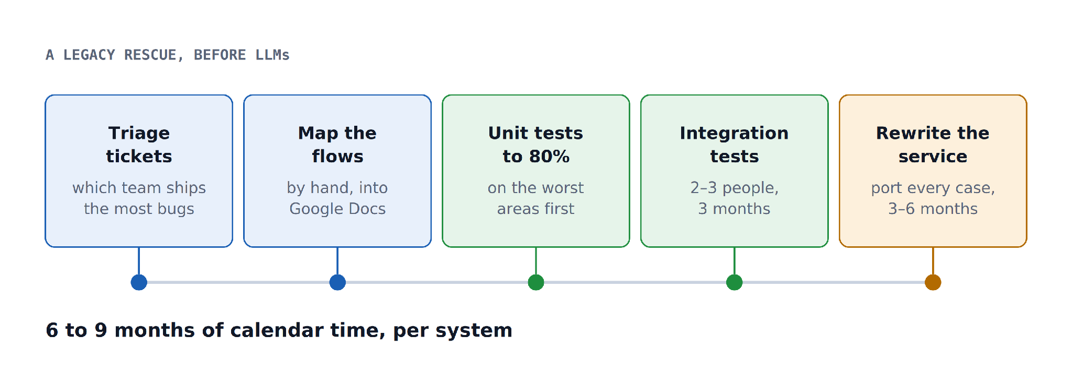
03 · THE CALL WE GET
How one of these rescues ran, before we had LLMs
On that engagement the code base was more than ten years old, running on a version of DB2 that had never been upgraded, and the executives wanted to move to Postgres for the licensing and the speed.
Prairie Dev Con 2026 · Tri Ho, Futurify
Notes:
We mapped the flows by hand into Google Docs and shared them among ourselves, brought unit coverage on the worst areas to at least 80%, added integration tests, then wrote the new service and ported every captured case. Multiple teams, but this was the shape per system.

Slide 8
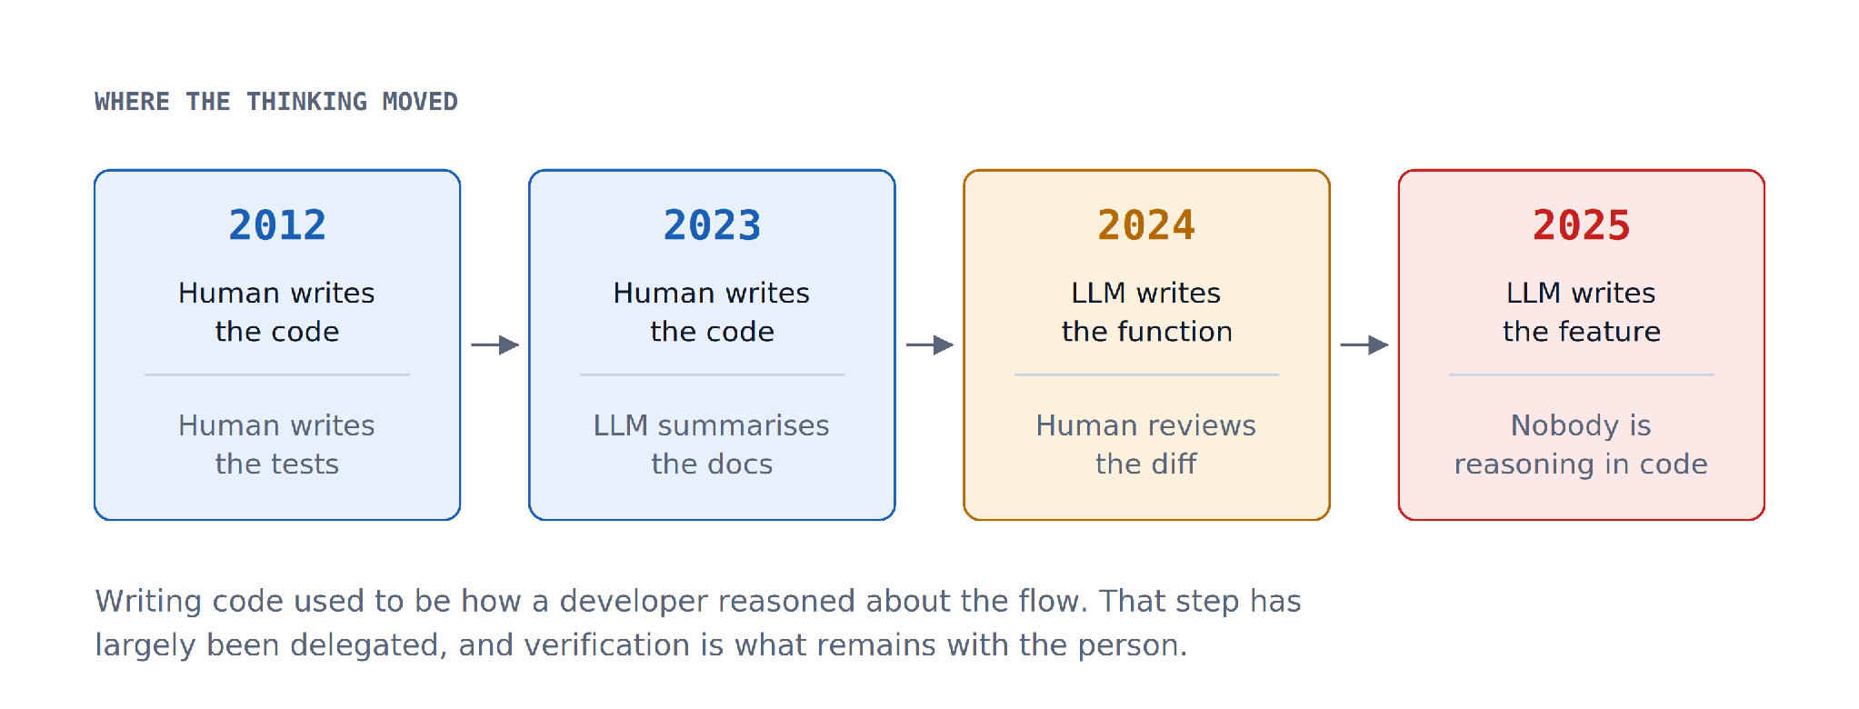
04 · THEN LLMs ARRIVED
The model took over the writing, and the checking stayed where it was
Prairie Dev Con 2026 · Tri Ho, Futurify
Notes:
We started with GPT-3.5 in early 2023, mostly summarising customer documentation and explaining what a function does. It hallucinated, so we still had to read the summaries carefully. It is much better now and still misses details here and there, even with Opus 5. As it improved we delegated a function, then several, then a class, then a small feature, with a person in the loop throughout.

Slide 9
04 · THEN LLMs ARRIVED
“How can we be sure the model only writes the code
we asked for, and leaves everything else alone?”
— a developer at one of our clients, asked last month
The honest answer we have is a better ability to test.
Pull requests are getting longer, and reviewing them well asks for something most teams have not built yet.
Prairie Dev Con 2026 · Tri Ho, Futurify
Notes:
This is the hinge of the talk. Writing code used to be how developers reasoned about the flow, and that part has largely been delegated. Verification is what is left, and most teams are not set up for it yet.

Slide 10
So how do we generate thousands of test cases
against more than 500 endpoints in a few hours?
The old answer was to put more developers on it. That answer has run out.
Prairie Dev Con 2026 · Tri Ho, Futurify
Notes:
Deliver the 'more developers' line as the joke it is, then move into the measurements.

Slide 11
05 · THE BENCH
We built a small API so the benchmark has a ground truth
It is not a real product. It is a simplified banking API with a deliberate mix of easy and awkward endpoints.
12 ENDPOINTS · A SIMPLIFIED BANKING API
GET /health
GET /accounts
GET /accounts/:id
POST /accounts
DELETE /accounts/:id // only if balance is zero — stateful
GET /transfers // needs auth
POST /transfers // needs funds + limits
POST /transfers/:id/reverse // needs a transfer to exist
POST /transfers/validate // 200 with { valid: false } — error-shaped
GET /accounts/:id/summary // returns the last transfer, not an aggregate
GET /limits // needs auth
PUT /limits // needs auth
Some of these have to be chained, since you cannot reverse a transfer before you have created one. In a client system that upstream endpoint often belongs to another team or service, so all you have is OpenAPI or a wiki page.
Prairie Dev Con 2026 · Tri Ho, Futurify
Notes:
Point out the traps: the stateful delete, the endpoint that returns 200 on a failure, and the one whose name does not describe what it returns. Those labels predict where models give up.

Slide 12
05 · THE BENCH
Asking an agent to “test the endpoint” is asking for a fair amount
The successful path
The refusals
A 200, carrying the record you expected to get back.
400, 401 and 403, and a 500 where you can force one.
The values
The shape
Is the balance the balance you were expecting to see?
Types and structure as specified, so a number arrives as a number.
You have the source in white box testing, part of it in grey box, and only the URL in black box. We started with the easiest of the three.
Prairie Dev Con 2026 · Tri Ho, Futurify
Notes:
Set the scope. We begin with white box because if the models cannot manage that, the rest does not matter much.

Slide 13
06 · ROUND ONE
The first thing we tried was simply handing over the code
THE SIMPLEST ENDPOINT ON THE FIXTURE
GET /accounts/:id
Auth: none Path params: id string required
Success — 200
{
"id": "acc_1",
"holder": "Ada Lovelace",
"currency": "CAD",
"balanceCents": 25000, // integer
"closed": false // boolean
}
Not found — 404 { "error": "not_found" }
The sample data is already seeded, so a model with the source in front of it ought to clear this comfortably.
Prairie Dev Con 2026 · Tri Ho, Futurify
Notes:
We measure pass rate on the first attempt, pass rate after repair, and coverage, then compare the models on the same protocol.

Slide 14
06 · ROUND ONE
Most of the models cleared it without much trouble
GET /accounts/:id · first attempt against final pass, median across trials
Model | 1st | Final | $ / trial | Wall
GPT-4.1 Mini | 100% | 100% | $0.002 | 4s
GPT-4.1 | 100% | 100% | $0.016 | 4s
Claude Sonnet 4.5 | 100% | 100% | $0.029 | 9s
Claude Opus 4.1 | 0% | 100% | $0.389 | 66s
Qwen3 Coder | 0% | 0% | $0.008 | 16s
Gemini 2.5 Pro | 0% | 0% | $0.014 | 12s
Gemini 2.5 Flash | 0% | 0% | $0.002 | 2s
Opus 4.1 missed on the first attempt and then repaired to a full pass. Coverage followed the final pass column exactly. The Gemini rows are the ones worth a closer look.
Prairie Dev Con 2026 · Tri Ho, Futurify
Notes:
Read the chart, then move to Gemini. Everyone else gets there, quickly and cheaply. Gemini is the interesting failure and the next slide is the evidence.

Slide 15
06 · ROUND ONE
The same source, the same response, a different assertion
WHAT THE API ACTUALLY RETURNS
WHAT GEMINI 2.5 FLASH ASSERTED
{
"id": "acc_1",
"holder": "Ada Lovelace",
"currency": "CAD",
"balanceCents": 25000,
"closed": false
}
[ { "pointer": "/id", "equals": "acc_1" },
{ "pointer": "/holder", "equals": "Ada..." },
{ "pointer": "/currency", "equals": "CAD" },
{ "pointer": "/balanceCents",
"equals": "25000" },
{ "pointer": "/closed", "equals": "False" } ]
It asserted a string where the API returns an integer, and a Python boolean where the API returns JSON.
The source code was available to it while it did that, and this accounts for the whole of the 0% column.
Prairie Dev Con 2026 · Tri Ho, Futurify
Notes:
Nothing subtle here. It read the handler and still asserted the wrong types.

Slide 16
06 · ROUND ONE
A green result does not mean a correct one.
If you read Gemini's own report and go no further, every test passed.
THE OTHER WAY THIS HAPPENS
POST /transfers/validate → HTTP 200
{ "valid": false, "reason": "amount_must_be_positive_integer" }
status == 200 → the test passes → the suite is green
A negative test that checks only the status code will pass happily on a rejected request, and nobody reads five hundred green rows one at a time.
Prairie Dev Con 2026 · Tri Ho, Futurify
Notes:
Two ways to be green and wrong: the wrong types, and negative tests that only look at the status. This is the line the whole talk hangs on.

Slide 17
07 · ROUND TWO
We wondered whether the models were simply out of date
The same endpoint and the same harness, run again on current models
Model | 1st | Final | $ / trial | Wall
GPT-5.4 Mini | 100% | 100% | $0.008 | 5s
Claude Opus 5 | 100% | 100% | $0.162 | 38s
GPT-5.2 | 100% | 100% | $0.193 | 56s
Claude Sonnet 5 | 0% | 100% | $0.036 | 14s
Gemini 3.1 Pro Preview | 0% | 0% | $0.017 | 7s
Gemini 3.5 Flash | 0% | 0% | $0.036 | 12s
The Gemini behaviour repeated a generation later. Sonnet 5 also missed on its first attempt and then repaired, which is worth explaining before we go further.
Prairie Dev Con 2026 · Tri Ho, Futurify
Notes:
Be open about the caveat: the engine has changed a great deal since the talk was submitted. These runs keep the original harness so the comparison still holds.

Slide 18
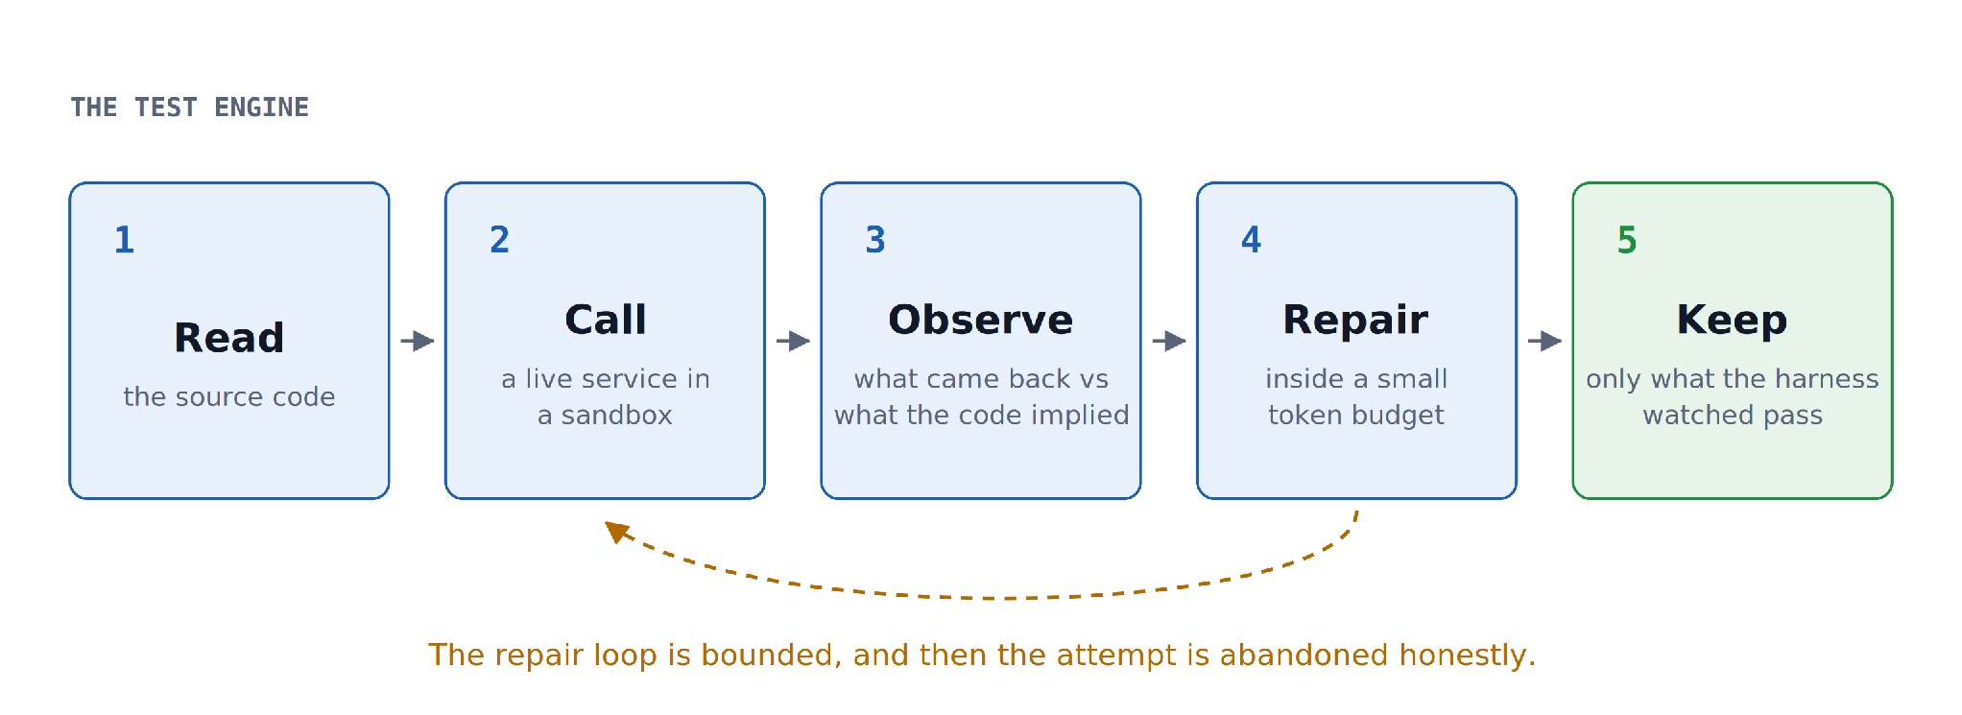
07 · ROUND TWO
Why there are two pass-rate columns
A test cannot be saved until the harness has watched it pass against the live service. Asking a model for tests and shipping the first green suite skips every stage after the first one.
Prairie Dev Con 2026 · Tri Ho, Futurify
Notes:
Five stages. The repair budget is what turns a 0% first attempt into a full final pass, and it is also why the naive approach produces false positives, since there is no observe or keep stage at all.

Slide 19
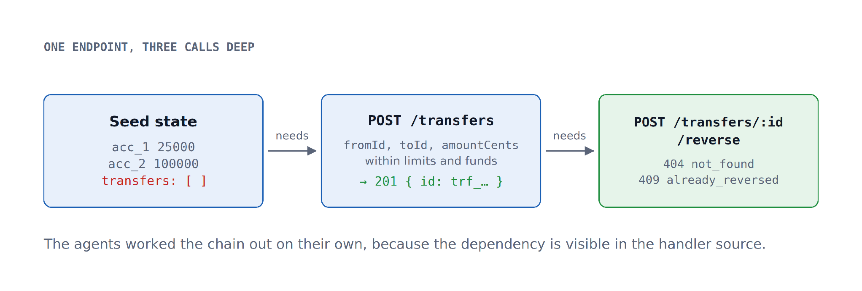
08 · ROUND THREE
Then an endpoint you cannot call on its own
Prairie Dev Con 2026 · Tri Ho, Futurify
Notes:
POST /transfers/:id/reverse. The seed ships with transfers empty, so the agent has to create a transfer within limits and funds, capture the id that comes back, and only then reverse it.

Slide 20
08 · ROUND THREE
Chaining the calls turned out not to be the hard part
POST /transfers/:id/reverse · median across trials
Model | 1st | Final | $ / trial | Wall
GPT-5.4 Mini | 100% | 100% | $0.014 | 8s
Claude Opus 5 | 100% | 100% | $0.493 | 82s
Claude Sonnet 5 | 0% | 100% | $0.156 | 63s
GPT-5.2 | 0% | 0% | $0.233 | 64s
Gemini 3.1 Pro Preview | 0% | 0% | $0.055 | 26s
Gemini 3.5 Flash | 0% | 0% | $0.097 | 27s
GPT-5.2 cleared the simple endpoint and did not clear this one. The cheapest model that passed did so at roughly a thirtieth of the cost of the most expensive.
Prairie Dev Con 2026 · Tri Ho, Futurify
Notes:
The models that passed worked the dependency out for themselves, because it is described in the source and the API docs.

Slide 21
08 · ROUND THREE
Everything they needed was in the file we handed them
THE SOURCE THE AGENT READ
function reset() {
state = {
accounts: [ { id: "acc_1", balanceCents: 250_00, ... },
{ id: "acc_2", balanceCents: 1_000_00, ... } ],
transfers: [], // ← empty on boot
limits: { dailyCents: 500_00, perTransferCents: 100_00 } }; }
app.post("/transfers", (req, res) => {
const t = { id: `trf_${state.seq++}`, fromId, toId, amountCents,
reversed: false };
res.status(201).json(t); // ← the id reverse needs
});
app.post("/transfers/:id/reverse", (req, res) => {
const t = state.transfers.find(x => x.id === req.params.id);
if (!t) return res.status(404).json({ error: "not_found" });
if (t.reversed) return res.status(409).json({ error: "already_reversed" });
});
Read the seed, read the two handlers, and the call order follows. The models that passed did exactly that.
Prairie Dev Con 2026 · Tri Ho, Futurify
Notes:
Good moment for the Gemini joke: I hope nobody here works at Google, and if you do, please stay afterwards and give me a short course on using it properly.

Slide 22
All of that works nicely when you already know what to hand the model.
Now point it at a million lines
of a code base nobody in the room has worked on.
Apache Fineract · the task: create a client
Prairie Dev Con 2026 · Tri Ho, Futurify
Notes:
This is the day job. You are dropped into a code base you did not write, across services you do not own, and this is where the hallucination starts to cost money.

Slide 23
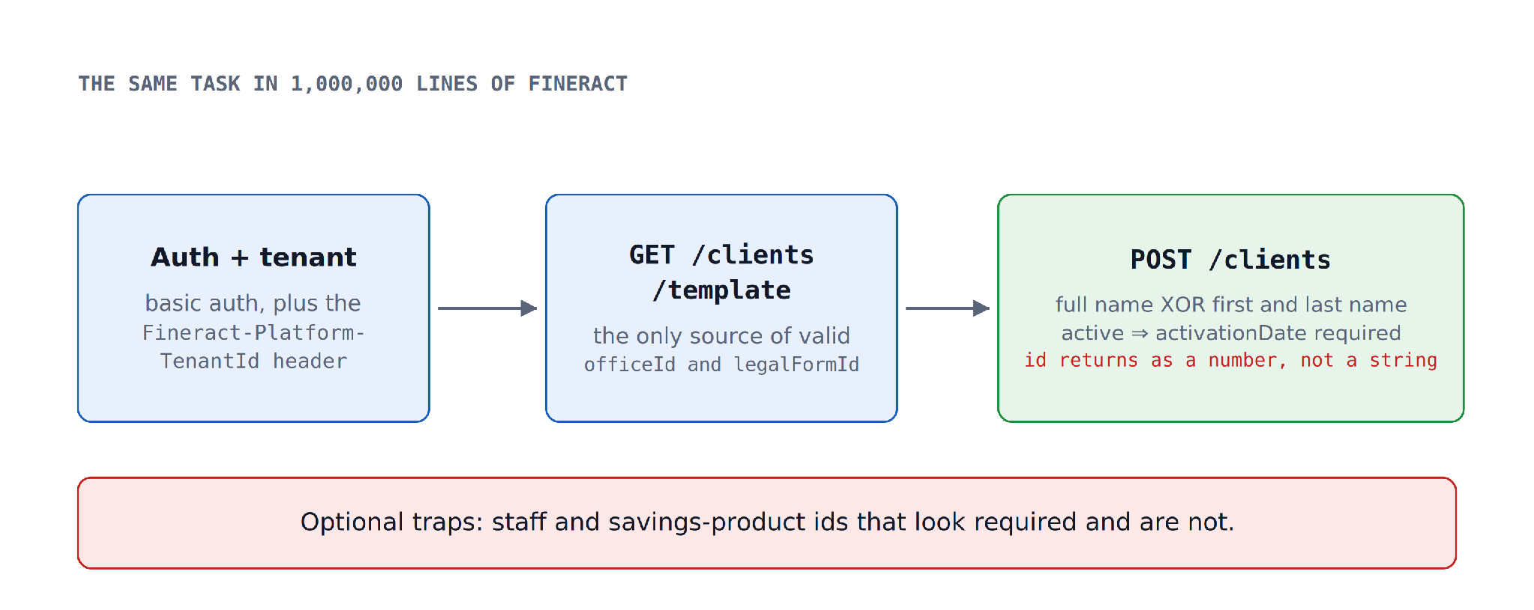
09 · THE REAL THING
Seven things POST /clients expects you to know
Prairie Dev Con 2026 · Tri Ho, Futurify
Notes:
Walk the seven: basic auth with a tenant header; the template call first; officeId and legalFormId are mandatory; either a full name or a first name but never both; an active client requires an activation date; staff and savings products look required and are not; and the id comes back as a number rather than a string.

Slide 24
09 · THE REAL THING
None of the three passed, and the reason is worth a minute
Three trials each, against POST /fineract-provider/api/v1/clients
Model | Trials | Final pass (median, range) | Assertion strength | Abandoned | Cost / trial
Claude Sonnet 5 | 3 | 0% (0–100%) | 0% | 1 | $0.440
GPT-5.4 Mini | 3 | 0% | 0% | 1 | $0.072
Gemini 3.5 Flash | 3 | 0% | 0% | 3 | $0.291
Every one of them did manage to create a client.
What let them down was the assertion they wrote about the response, and that only becomes visible the second time the test is run.
Prairie Dev Con 2026 · Tri Ho, Futurify
Notes:
Set the hook. They all created a client successfully, so the zero needs explaining, and the explanation is on the next slide.

Slide 25
09 · THE REAL THING
The same idea, carried out four different ways
RAW ASSERTIONS, TAKEN STRAIGHT FROM THE TRIAL FILES
Claude Sonnet 5 SURVIVES REPLAY
[{"pointer":"/officeId","equals":1},{"pointer":"/clientId"},{"pointer":"/resourceId"}]
observed clientId = 4 ← saw a value, and deliberately did not bind it
Claude Sonnet 5 FAILS REPLAY
[{"pointer":"/officeId","equals":1},{"pointer":"/clientId","equals":"__same_as_resourceId__"}]
observed clientId = 6 ← the right idea, never resolved
GPT-5.4 Mini FAILS REPLAY
[{"pointer":"/officeId","equals":1},{"pointer":"/clientId","equals":1},{"pointer":"/resourceId","equals":1}]
observed clientId = 1 ← asserted exactly what it happened to see
GPT-5.4 Mini FAILS REPLAY
observed clientId = 2 ← asserted exactly what it happened to see
The trial that survived was the one that refused to pin the id. The others recorded a value that will be different tomorrow.
Prairie Dev Con 2026 · Tri Ho, Futurify
Notes:
They had the right idea and the wrong execution, which is a far more encouraging problem than not understanding the API, because it can be fixed with direction.

Slide 26
10 · GIVING THEM DIRECTION
So we stopped asking for tests first, and asked for the rules
We ask the agent to write down what it had to know in order to make the call work, and only then to write tests from it.
THE PLAYBOOK TEMPLATE
{ "target": "<target name>", "updatedAt": "<ISO 8601>",
"endpoints": {
"<endpointId>": {
"method": "<HTTP method>", "path": "<route template>",
"verifiedStatus": 200,
"auth": "<auth and tenancy, as observed on a call that worked>",
"requiredFields": ["<field>"], "optionalFields": ["<field>"],
"responseShape": { "<field>": "<json type>" },
"invariants": ["<property true on every call>"],
"dependsOn": [ { "what": "<record that must exist first>",
"endpointId": "<endpoint that creates it>" } ]
} } }
Prairie Dev Con 2026 · Tri Ho, Futurify
Notes:
The playbook is a discovery artifact rather than a test. It records what the agent learned about calling the endpoint correctly, in a shape another agent can pick up and use.

Slide 27
10 · GIVING THEM DIRECTION
What the agent wrote down for Fineract
PLAYBOOK ENTRY · clients-create
{ "target": "fineract", "updatedAt": "2026-09-21T12:15:25.827Z",
"endpoints": { "clients-create": {
"method": "POST",
"path": "/fineract-provider/api/v1/clients",
"verifiedStatus": 200,
"auth": "Basic auth with Fineract-Platform-TenantId: default",
"requiredFields": ["officeId", "legalFormId", "firstname", "..."],
"optionalFields": ["middlename", "externalId"],
"responseShape": { "resourceId": "number", "clientId": "number" },
"invariants": ["resourceId equals clientId"],
"dependsOn": [ { "what": "officeId and legalFormId",
"endpointId": "GET /.../clients/template",
"note": "To get valid officeId and legalFormId" } ]
} } }
The invariant on that entry is the line that addresses the replay problem: assert that resourceId equals clientId, rather than asserting that clientId equals 4.
Prairie Dev Con 2026 · Tri Ho, Futurify
Notes:
It found the template call on its own, recorded the response types, and wrote down the invariant. That invariant is precisely what the failing trials were missing.

Slide 28
10 · GIVING THEM DIRECTION
Then we stopped paying to learn the same lesson twice
The playbook records what is true. Memory records what went wrong last time.
MEMORY ENTRY
Kept per model and endpoint
{
"modelId": "google/gemini-3.5-flash",
"endpointId": "clients-create",
"trials": 3,
"avoid": [
"A request omitted the tenant header and the
server returned a bare 400 with no detail.
Header names use hyphens, not underscores."
]
}
What to avoid, and what worked.
Read before the next run
Discovery across a million lines is the expensive part, so we would rather pay for it once.
What we want is a pipeline that improves a little every day on an inexpensive model, rather than one that ran well yesterday and began again from nothing this morning.
Prairie Dev Con 2026 · Tri Ho, Futurify
Notes:
We burned through tens of thousands of tokens getting here, which is a good argument for writing down what the agent learns.

Slide 29
10 · GIVING THEM DIRECTION
We also give the agents the house rules up front
A general set to begin with, and then whatever the particular stack asks for.
1
Do the discovery before you write tests
Read the docs, read the source and probe the live service, because the documentation is often out of date.
2
Get the auth right before debugging anything else
A good deal of wasted budget is a 401 being read as a logic problem.
3
One test, one behaviour
Straightforward, and routinely ignored by generated suites.
4
A test owns the state it depends on
If it needs a client, it creates a client rather than borrowing one, unless we say otherwise.
5
A test that cannot run twice is not a test
Bind the ids and assert the invariant rather than the value you happened to see.
Every team ends up with its own set, and we usually write them together with the client's engineers over the first few weeks.
Prairie Dev Con 2026 · Tri Ho, Futurify
Notes:
Five examples out of many. The last rule is the one that would have saved every failing trial we looked at earlier.

Slide 30
11 · THE QUALITY GATES
Rules ask politely, and agents do not always listen
Models are not deterministic, so some runs follow the rules carefully and some do not.
They behave a little like clever children
So we added a deterministic check
They have heard the rule, they can repeat it back to you, and on any given run they may decide it does not apply today.
At the end of every run, something that answers yes or no, and sends the work back when the answer is no.
The rules and the playbook improve the odds. The gates are what make the outcome dependable.
This was the change that moved the Fineract results, and it is the part most teams leave out.
Prairie Dev Con 2026 · Tri Ho, Futurify
Notes:
Be clear that prompts and rules alone were not enough for us. The gates are ordinary code, and that is the point of them.

Slide 31
11 · THE QUALITY GATES
The gates are ordinary code
THE GATE KEEPS THE VALUES FROM THE RUN IT JUST WATCHED
const assertions = args.assertions as AssertionSpec[];
const setup: SetupStep[] = Array.isArray(args.setup) ? ... ;
args.request ?? this.lastRequest
When the agent reports a green result, the gate asks it to prove the claim. It keeps the values from the previous run and runs the test again. If the agent pinned an id it happened to see in the response, the second run will not match, the gate fails it, and the agent is asked to correct the test until it holds or the budget runs out.
A test that survives its own replay is a test you can put in CI tomorrow morning.
Prairie Dev Con 2026 · Tri Ho, Futurify
Notes:
This is the 'prove it' step. Say plainly that we do not ask the model whether the test was good; we replay it against the service.

Slide 32
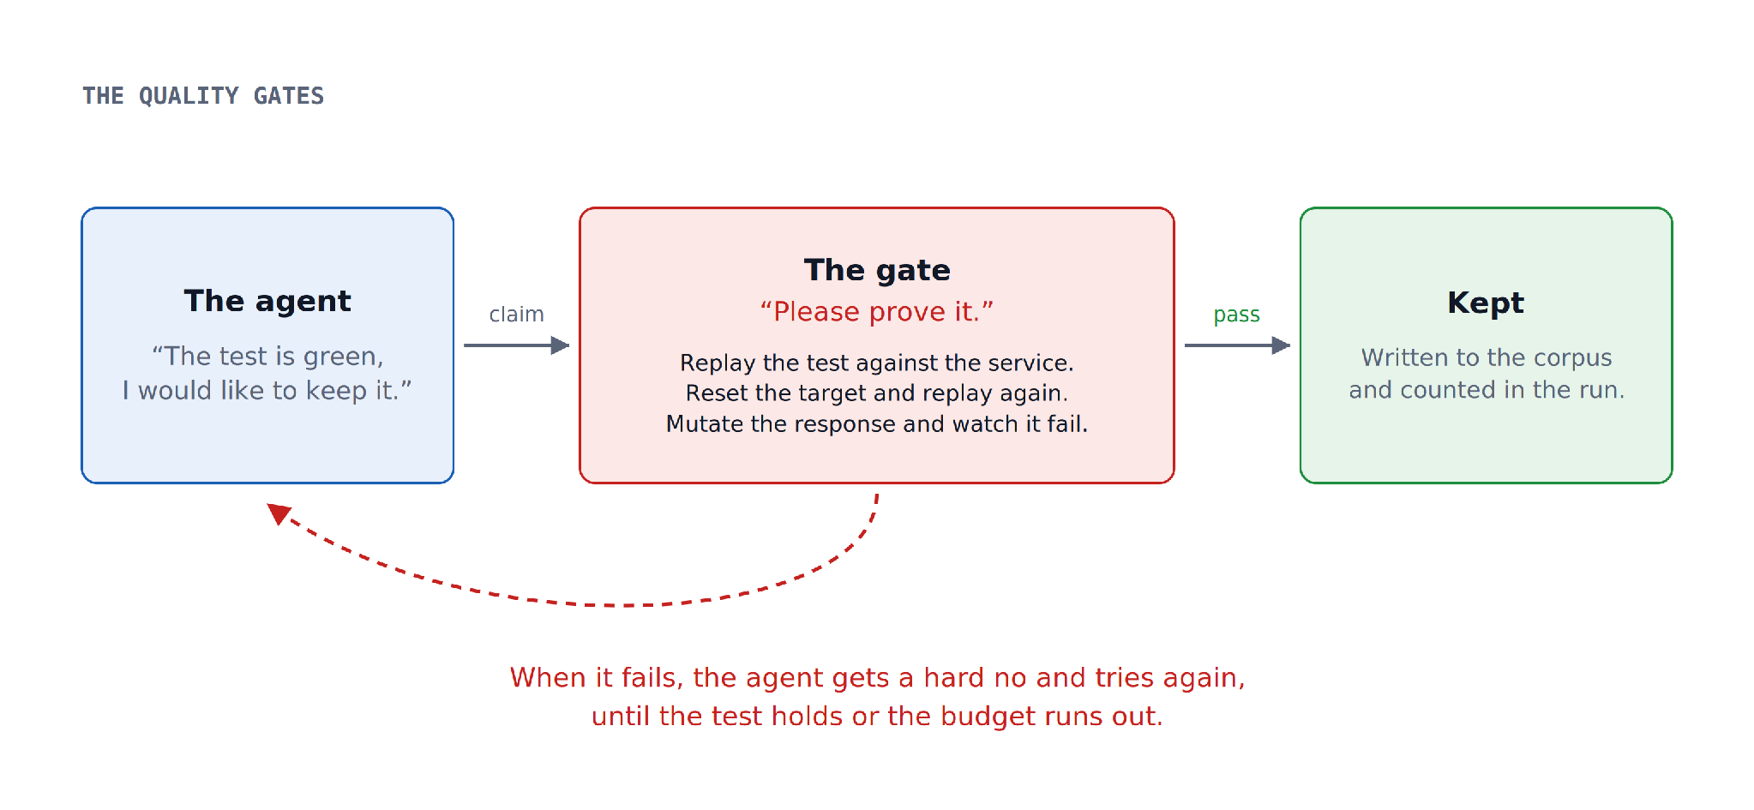
11 · THE QUALITY GATES
How the gate and the agent negotiate
Prairie Dev Con 2026 · Tri Ho, Futurify
Notes:
Walk the loop once, slowly. Claim, replay, reset, mutate, and either keep it or hand it back with a hard no.

Slide 33
11 · THE QUALITY GATES
What the gates actually check
STRUCTURAL
EXECUTION
the assertions hold on the response just watched
the claimed status matches the observed status
captured values are substituted downstream
any {{name}} referenced is produced by a setup step
a catalog dependency has not been ignored
the setup chain runs from a clean start
the test passes a second time
the test passes after the target is reset STRICT_ISOLATION=1
the assertions catch at least 70% of mutations MUTATION_THRESHOLD
The mutation check is the one that catches an assertion which technically passes while testing nothing of consequence.
Prairie Dev Con 2026 · Tri Ho, Futurify
Notes:
Mutation means flipping a boolean, shifting a number, dropping a field or changing the status. If the test still passes, the assertion was not doing any work.

Slide 34
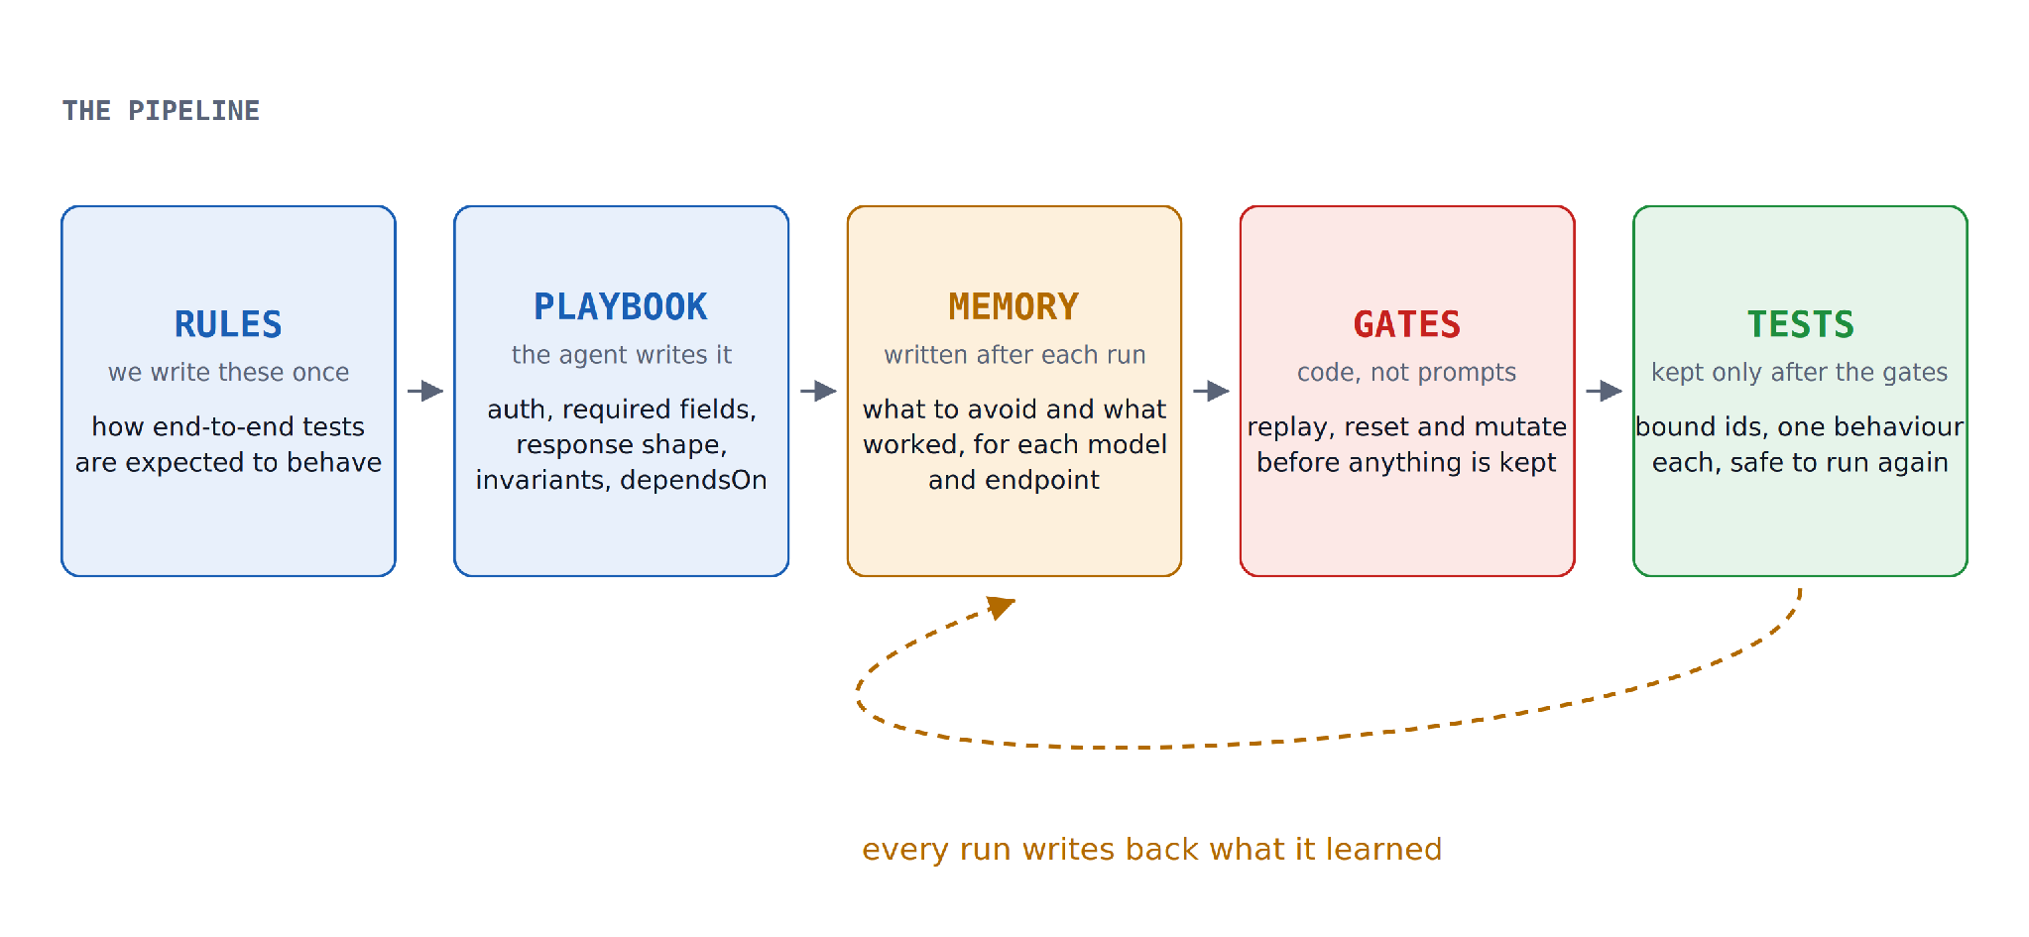
12 · THE PIPELINE
Putting the four pieces together
Prairie Dev Con 2026 · Tri Ho, Futurify
Notes:
Rules go in once. The agent writes the playbook. Each run writes back to memory. The gates decide what is kept. This loop is what makes an inexpensive model workable on a daily schedule.

Slide 35
12 · THE PIPELINE
The same endpoint, with the rules and gates in place
No hand-written hints. The agents worked it out and the tests survived the gates.
Manifest | Trials | First-attempt pass | Final pass | Assertion strength | Coverage | Abandoned | Cost / trial
POST /clients + GET /clients/{id} | 2 | 2/4 | 3/3 | 98% | 3/4 | 1 | $1.17
Three out of three on the final pass
One trial was still abandoned
The same endpoint that produced nothing but zeros earlier in this talk.
We report that number next to the pass rate, because a leaderboard without it is not telling you much.
Assertion strength of 98% means the kept tests failed on almost every mutation we threw at the response, which is the number we care about most.
Prairie Dev Con 2026 · Tri Ho, Futurify
Notes:
This is the payoff for the middle of the talk. Basic rules, no hints, and the agents generate tests for a complex endpoint that hold up on replay.

Slide 36
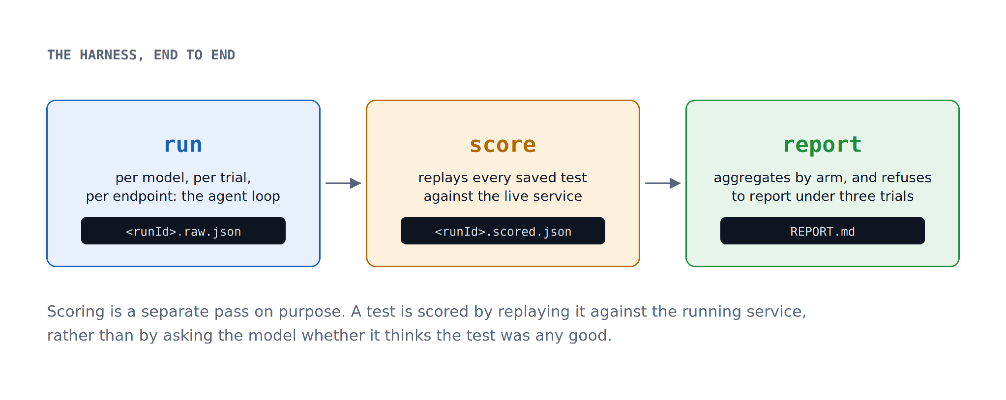
13 · THE HARNESS
Three passes, and an artifact from each one
The report refuses to publish a cell with fewer than three trials, which has saved us from reading a good deal of noise as a result.
Prairie Dev Con 2026 · Tri Ho, Futurify
Notes:
Scoring is deliberately a separate pass. A test is scored by replaying it against the running service, not by asking the model whether it thinks the test was any good.

Slide 37
13 · THE HARNESS
What the agent is given to work with
THE AGENT'S TOOLS
query_source, query_source_graph, list_sources, search_sources discovery
safe_http_request (method, path, headers, body, capture) probing
write_playbook_entry catalog
search_notes catalog + lessons
record_discovery, save_test notes, commit
THE TARGET CONFIGURATION
{ "name", "baseUrl", "sourceRoot", "manifest", "healthPath",
"connectionFacts": [...], "tlsInsecure",
"reset": { "kind": "none" | "http" | "command", ... } }
save_test sits at the end of that list for a reason. It stays out of reach until the gates have finished with the test.
Prairie Dev Con 2026 · Tri Ho, Futurify
Notes:
Worth showing developers that the tool surface is small. Discovery, probing, writing to the catalog, and a commit that is gated.

Slide 38
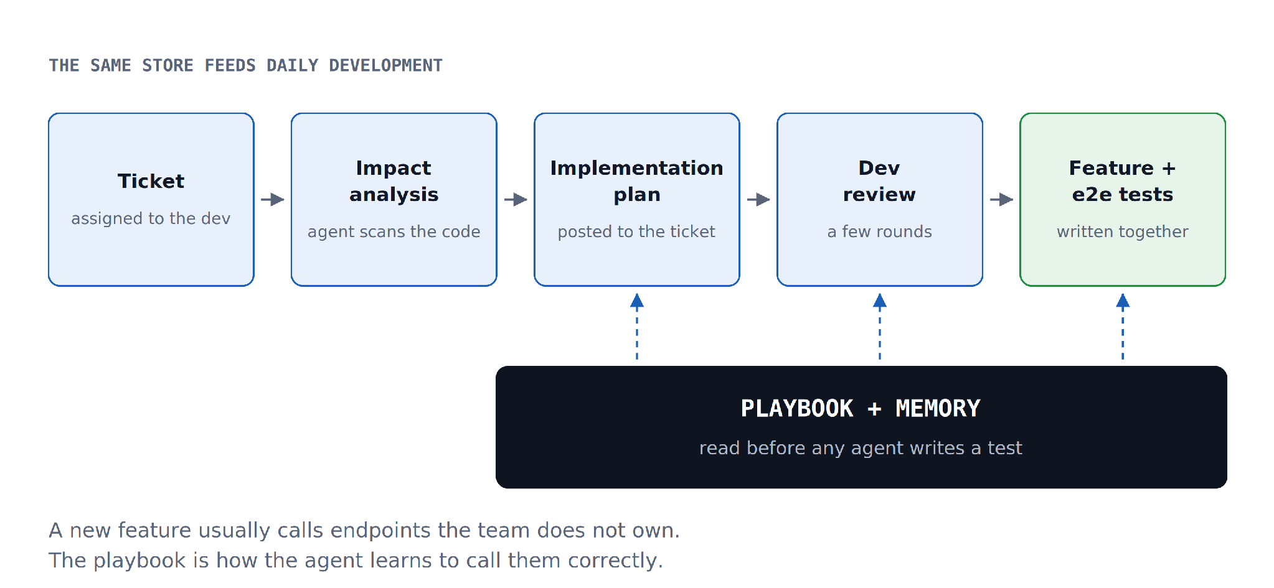
14 · IN PRODUCTION
Generating the tests once was never the goal
Prairie Dev Con 2026 · Tri Ho, Futurify
Notes:
APIs keep changing, so the tests need updating. We built the suite to capture how the current system behaves, so we can understand it well enough to build the new one. Every developer works with at least two agents: read the ticket, scan the code, run the impact analysis, publish an implementation plan back to the ticket, a few rounds of review, then the feature and its end-to-end tests. The playbook and memory are what let those agents call endpoints the team does not own.

Slide 39
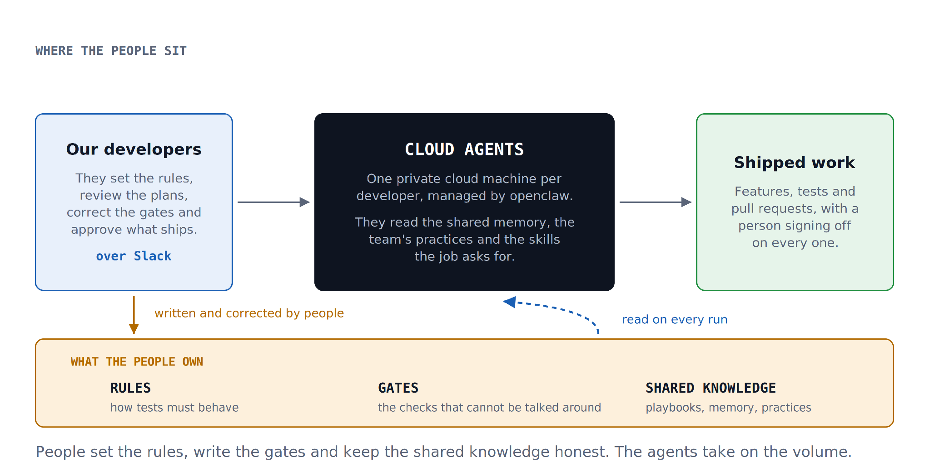
14 · IN PRODUCTION
Every developer works with agents on a machine of their own
Prairie Dev Con 2026 · Tri Ho, Futurify
Notes:
Each developer has cloud agents on a private machine we control, managed by openclaw. They have access to the shared memory of the project, our practices as an organisation, and the skills the work calls for. We talk to them through Slack.

Slide 40
14 · IN PRODUCTION
Will the agents replace developers?
No. They take on the volume, and the people keep the judgement.
Since we moved the agents onto cloud machines and started talking to them in Slack, our productivity has risen noticeably. The people still set the rules, write the gates, keep the shared knowledge honest and sign off on what ships.
I keep a clone of myself, so my team can ask it questions while I am in a meeting.
Our developers have theirs as well, which means that when a question comes up about a feature and the person who wrote it is on holiday, we can ask their clone instead.
Prairie Dev Con 2026 · Tri Ho, Futurify
Notes:
Close the production section on a light note, and be ready for questions about how much of the clone's answer people trust.

Slide 41
Three things I would take home
1
A green result tells you the assertions ran, not that they were the right assertions.
Gemini asserted a string against an integer with the source code in front of it, and reported a full pass.
2
Bind the ids and assert the invariant, so the test still works tomorrow.
The one trial that survived replay was the one that saw a value and chose not to pin it.
3
Discovery is the expensive part, so pay for it once and write down what you learn.
Rules, then a playbook, then memory. That is what makes an inexpensive model dependable enough to run every day.
And none of it works without a deterministic gate at the end, and a person at the beginning. Thank you — I am happy to take questions.
Prairie Dev Con 2026 · Tri Ho, Futurify
Notes:
Likely questions: what happens with no source access at all; how the playbook is versioned; what this costs per day across 500 endpoints; and how the gates handle endpoints that are genuinely non-deterministic.

